Slide 1
April 25, 2023
ROUND ROCK PRESERVATION
Shirley Marquardt - President RR Preservation
Notes:
Good Evening. I am Shirley Marquardt, President of Round Rock Preservation.
I officially call our Annual Meeting to order. We ask everyone to turn off their video and audio at this time.
If you wish to make comments during the meeting, you can type your comments into the Chat Button, which you will find at the bottom of your screen.
Comments will be addressed at the end of the program.

Slide 2
AGENDA
Call to Order President
RRP (The Organization) President
Toast to 2022 President
Board Nominations Vice President
Memberships Secretary
Finances Treasurer
By Laws Phebe Davol
Projects
-- History Bricks Heritage Trail West President
-- Stagecoach Inn President
-- Kenney Fort Vice President
AGENDA
Notes:
Here is the first half of the agenda.

Slide 3
AGENDA
CITY PRESERVATION PROGRAM UPDATE Kerstin Harding
CITY COMP PLAN (Annual Report) Kerstin Harding
PATH TO THE FUTURE President
ANNUAL AWARDS Judy Anderson
ELECTION RESULTS Frank Darr
ATTENDEE INPUT Attendees
ADJOURN MEETING President
RRP MEETINGS (Second Tuesdays, 7 pm, Zoom)
AGENDA
(Continued)
Notes:
The agenda continues here.

Slide 4
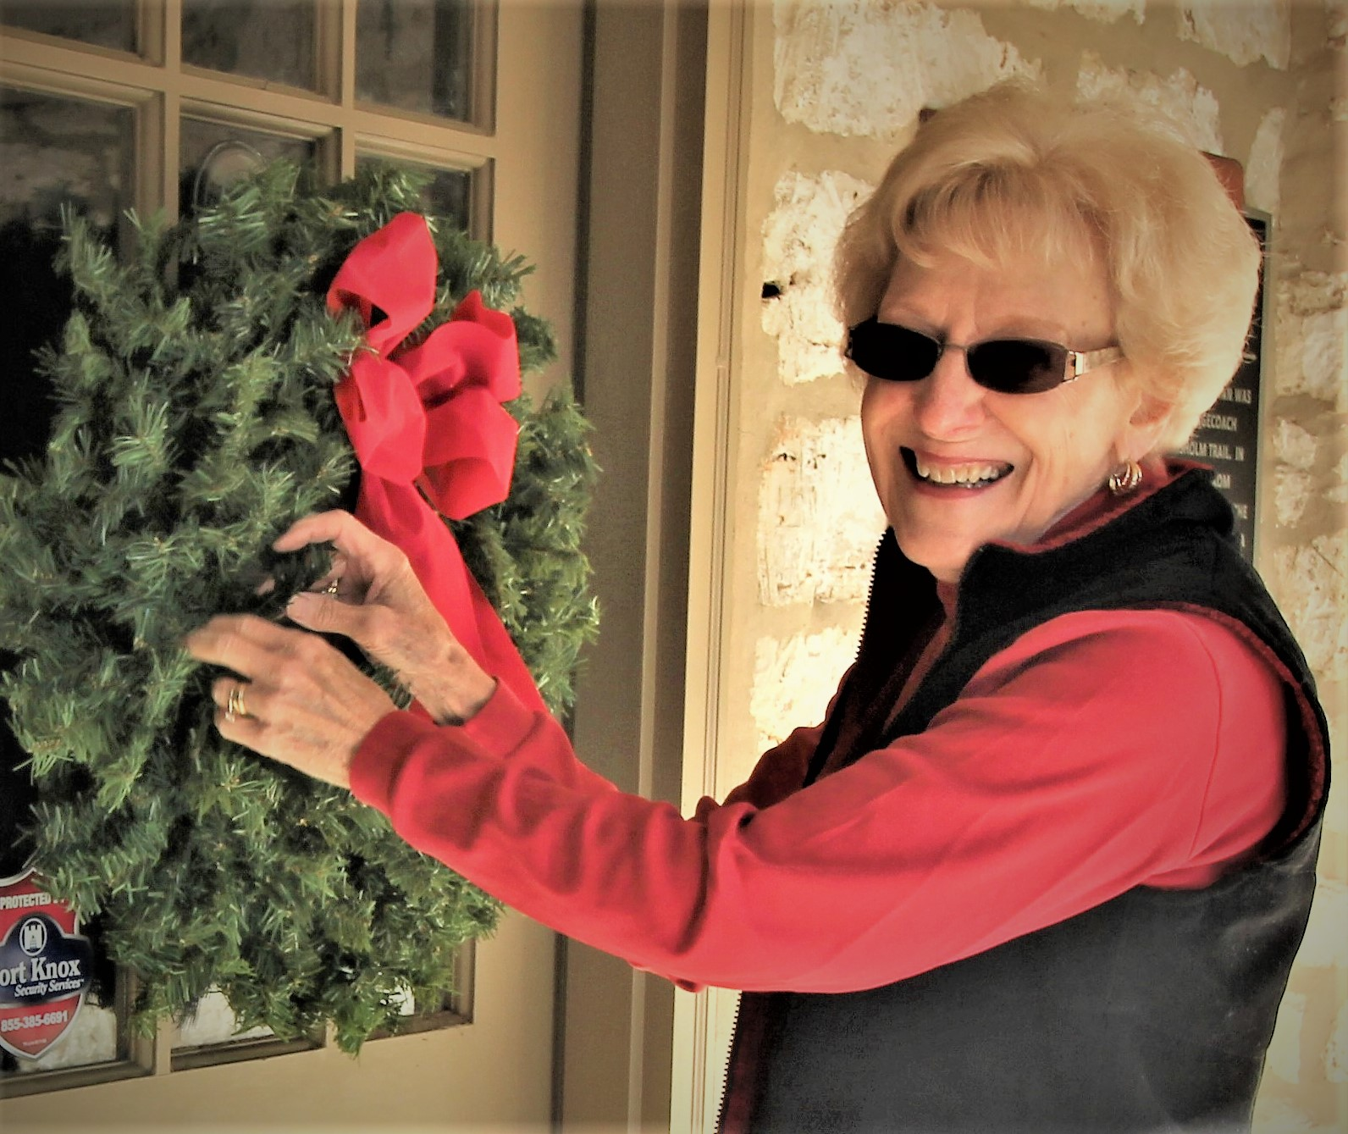
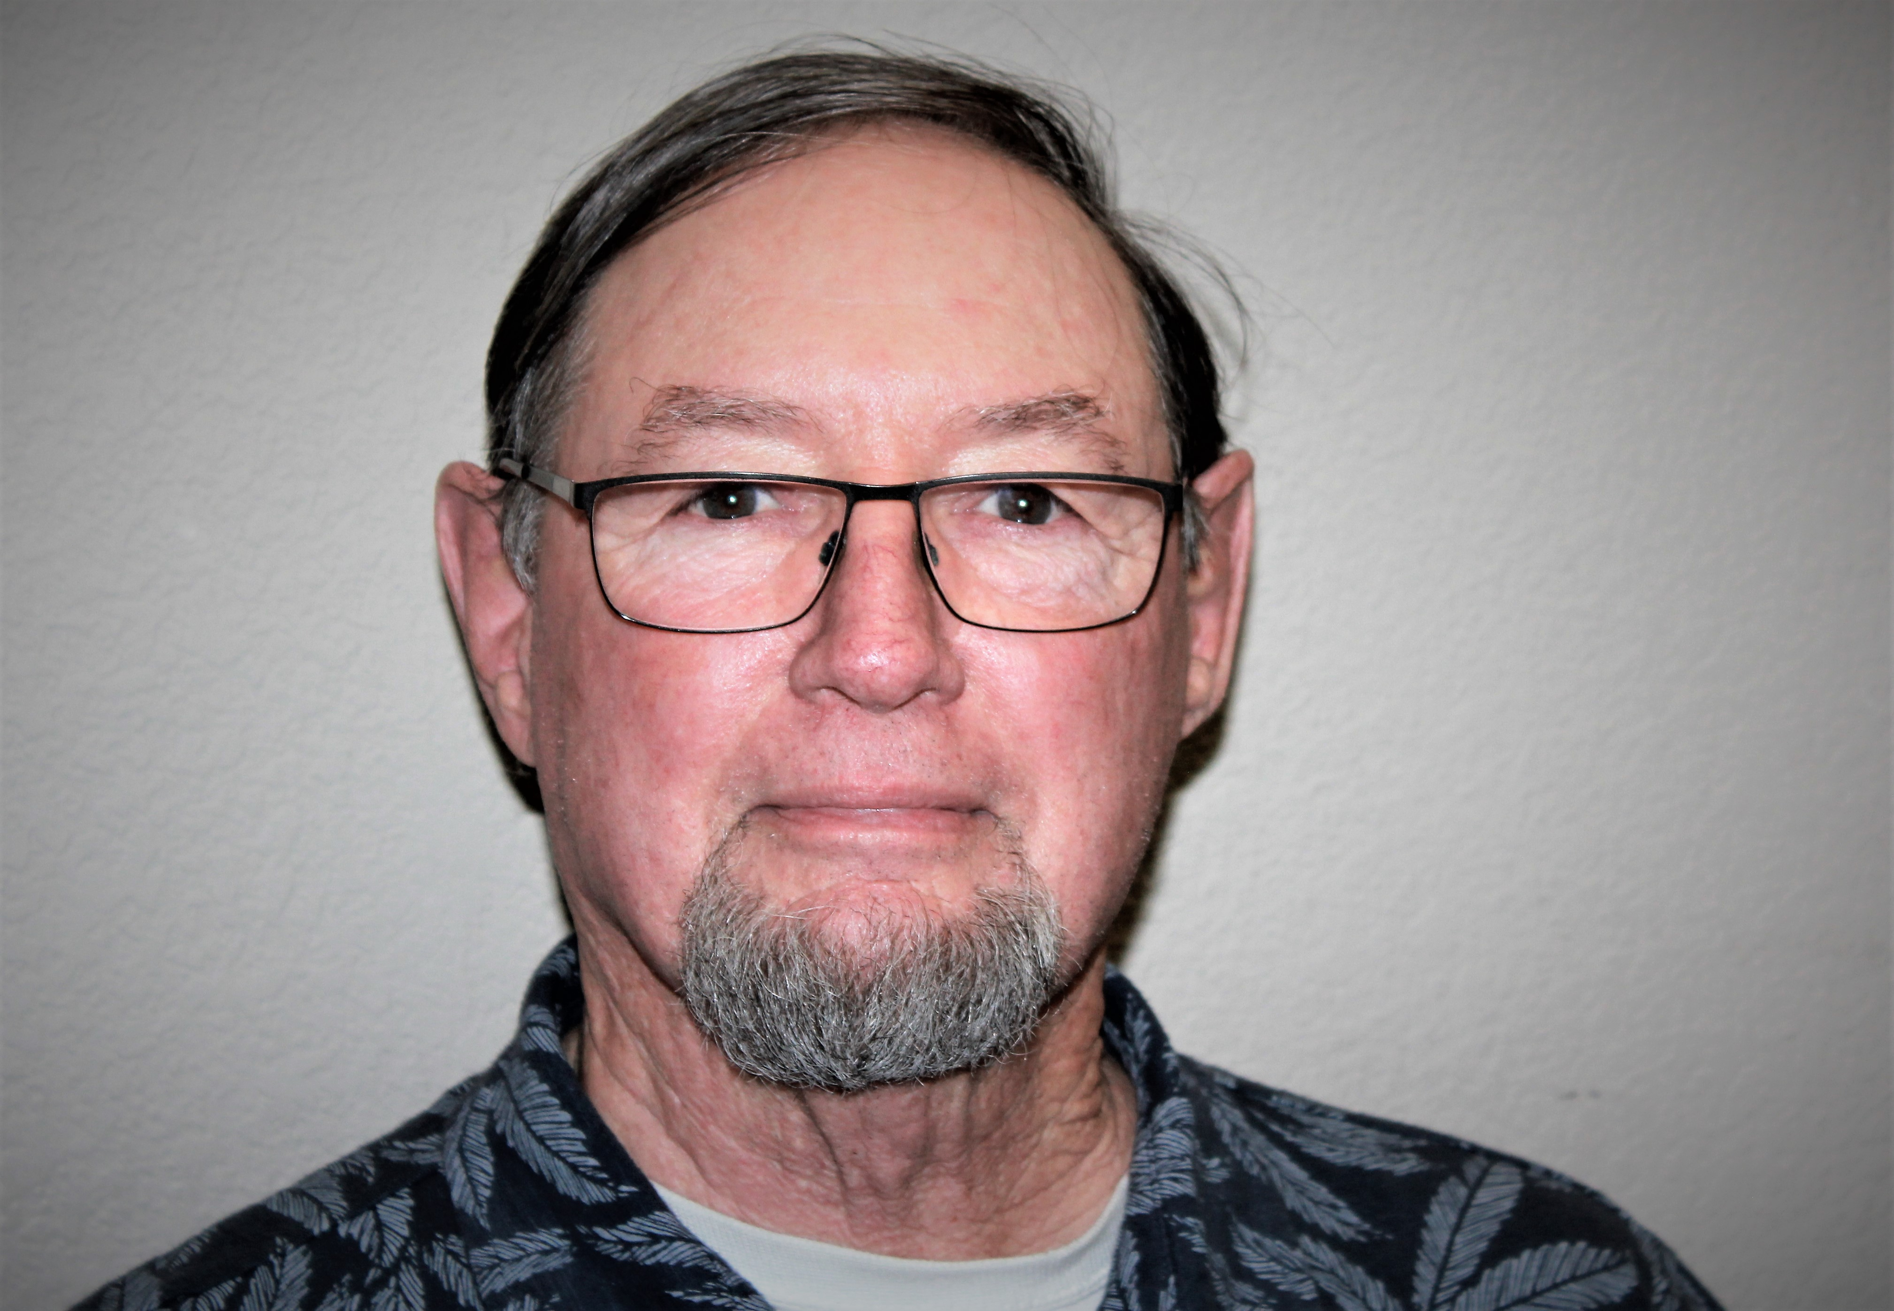
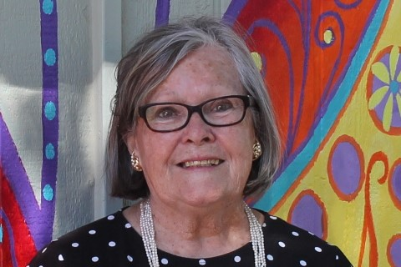
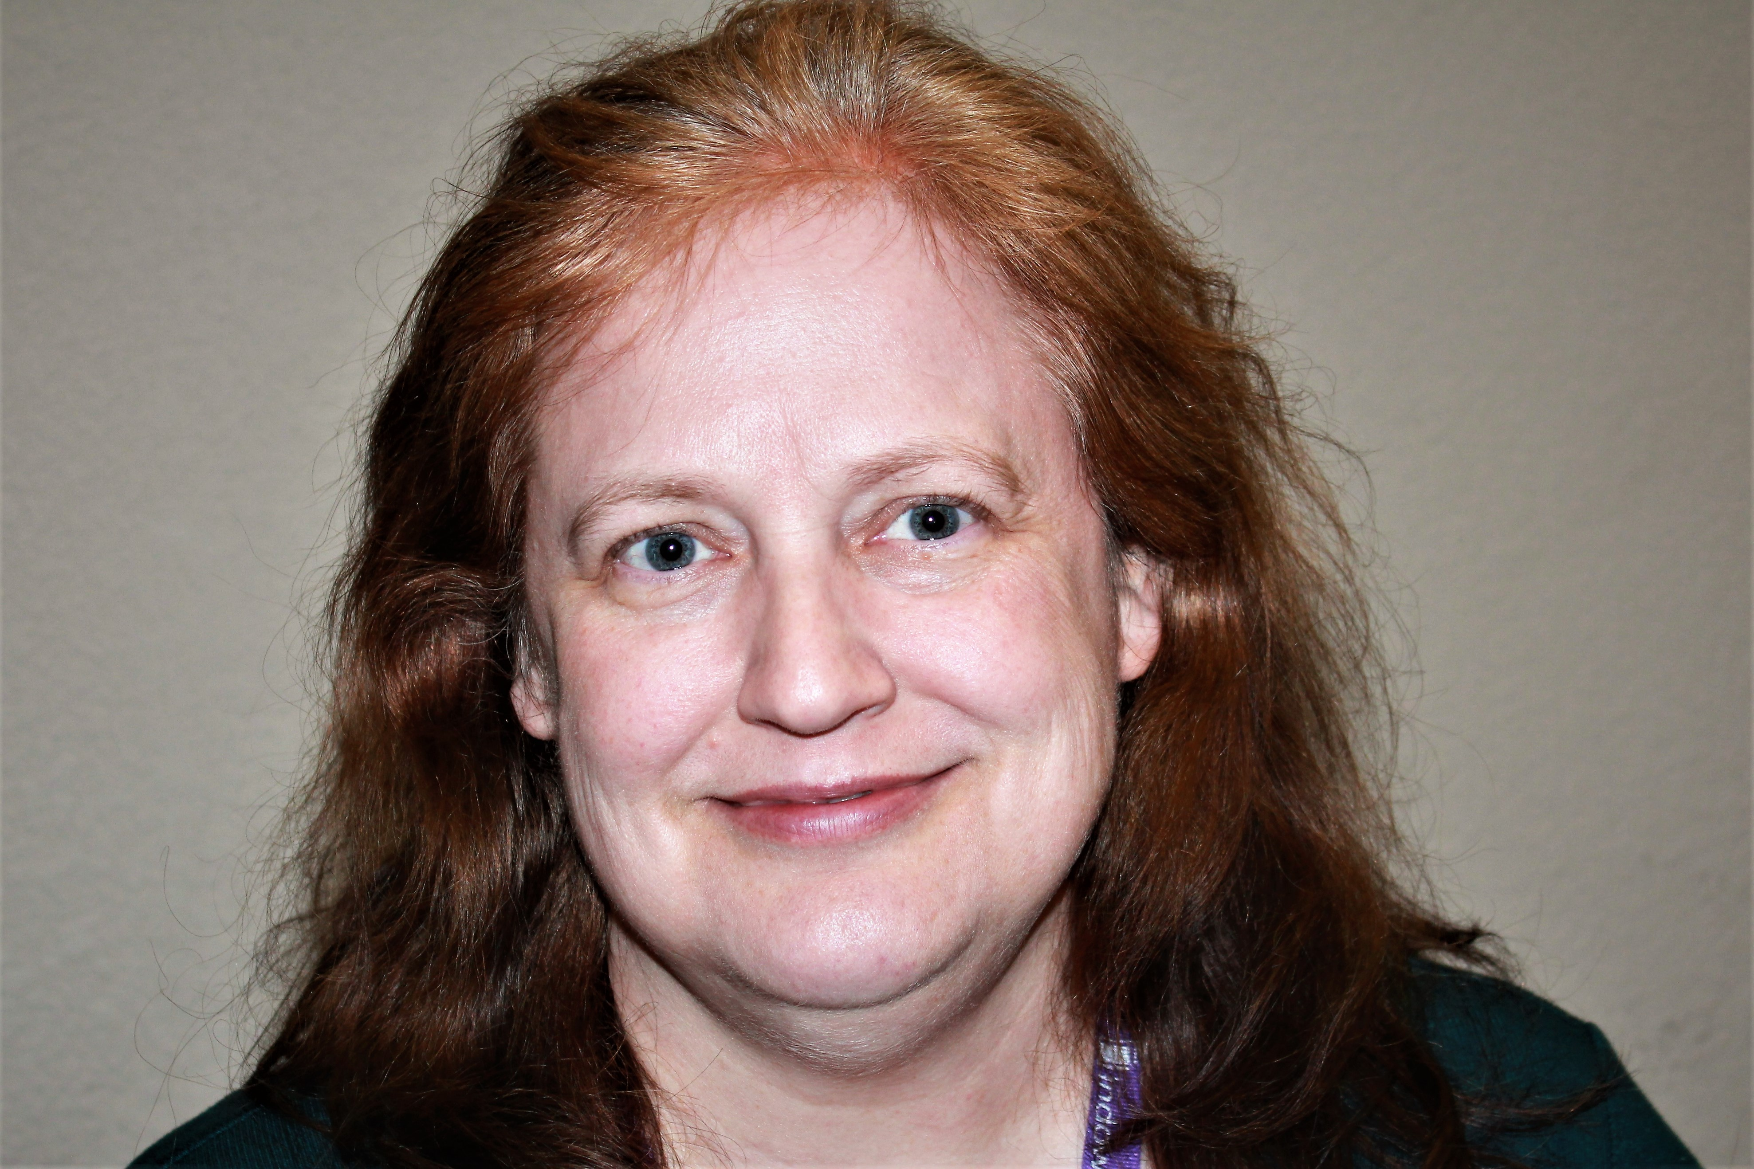
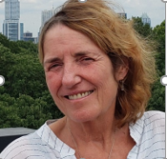
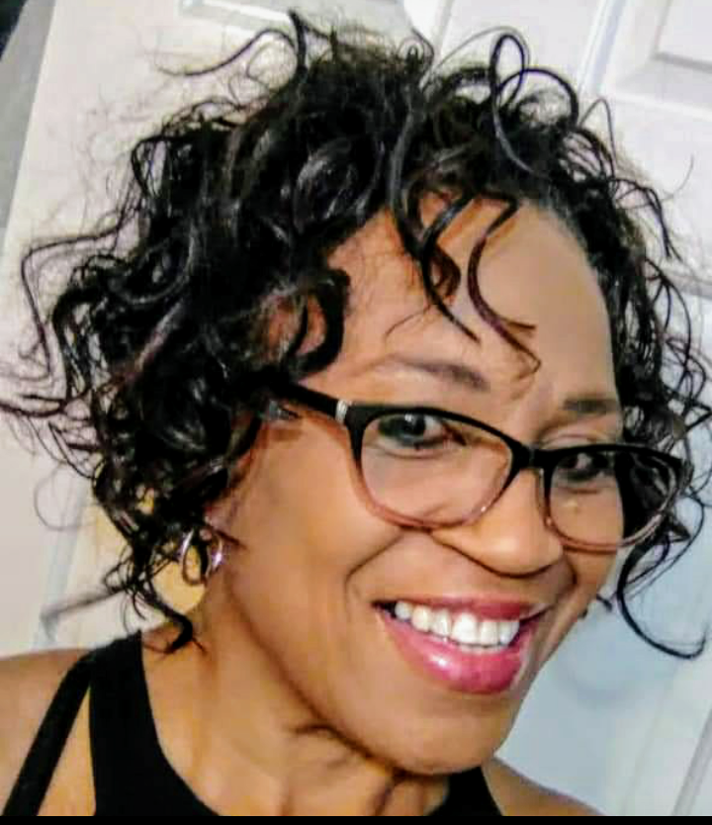
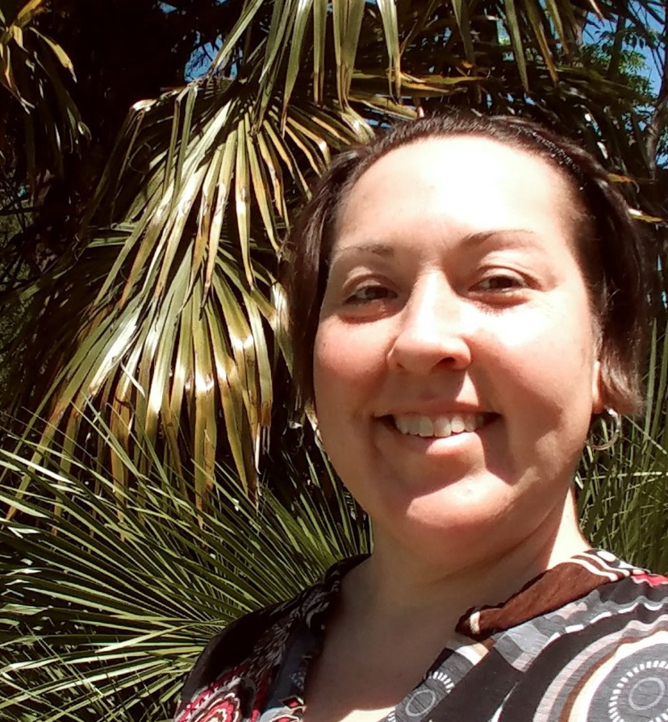
BOARD OF DIRECTORS
JUDY ANDERSON FRANK DARR SHIRLEY MARQUARDT KERSTIN HARDING
President Vice President Secretary/Member Chair Treasurer
PHEBE DAVOL BLYTHE PLUNKETT TINA STEINER
Director Newspaper Editor Director
Notes:
This chart shows our RRP Board of Directors.
The board members have been elected from our membership & serve on a volunteer basis.

Slide 5
ROUND ROCK PRESERVATION
EIN: 81-2339800
Moving Forward – Respecting the Past
Advocate
Educate
Inspire
Achieve
Shirley Marquardt, RRP President
Notes:
RRP’s mission is to preserve the most significant historic assets in the City of Round Rock and to provide historic preservation education to the public.
RRP strives to both embrace city development efforts while advocating for respect of the city’s past.

Slide 6
ROUND ROCK PRESERVATION
EIN: 81-2339800
Nonprofit Public Charity (501c3)
Founded 7 years ago
Authorized by State & IRS
Governed by Bylaws & Operating Procedures
Operate under direction of Board of Directors
Advocate for historic preservation
Rely on City and Community Support
Funded by memberships & donations
Shirley Marquardt, RRP President
Notes:
What is RRP?
RRP is a nonprofit public charity authorized by both the State of Texas and the Federal Government (IRS).
Our focus is to advocate for HP within the City of Round Rock.
RRP funds our mission and programs through membership dues and donations from the public.

Slide 7
RRP
PUBLIC
CITY OF RR
CITY
HPO/HPC
ROUND ROCK PRESERVATION (RRP)
HISTORIC PROPERTY OWNERS
OTHER NON-PROFITS
COMMUNITY SUPPORTERS
CRAIG MORGAN, MAYOR
LAURIE HADLEY, CITY MGR
CITY DEPARTMENTS/OFFICES
BRAD WISEMAN, DIR PLANS/DEV
RICK ATKINS, DIR PARKS/REC
JOELLE JORDAN, HPO
KERSTIN HARDING
NICOLE HAGGERTY
SHARON WHITAKER, HPC CHAIR
PAMELA ANDERSON VICE CHAIR
Shirley Marquardt, RRP President
Notes:
This chart shows the environment in which RRP operates.
RRP is a stand-alone organization & we are separate from the City of Round Rock.
RRP follows state & federal nonprofit guidelines & we set/guide our own activities.
Our success depends on support received from the public, the city of RR, and the City’s HP Office.
The City HPO uses a City Historic Preservation Commission to help implement their program.

Slide 8
A TOAST TO 2022
Shirley Marquardt, RRP President

Slide 9
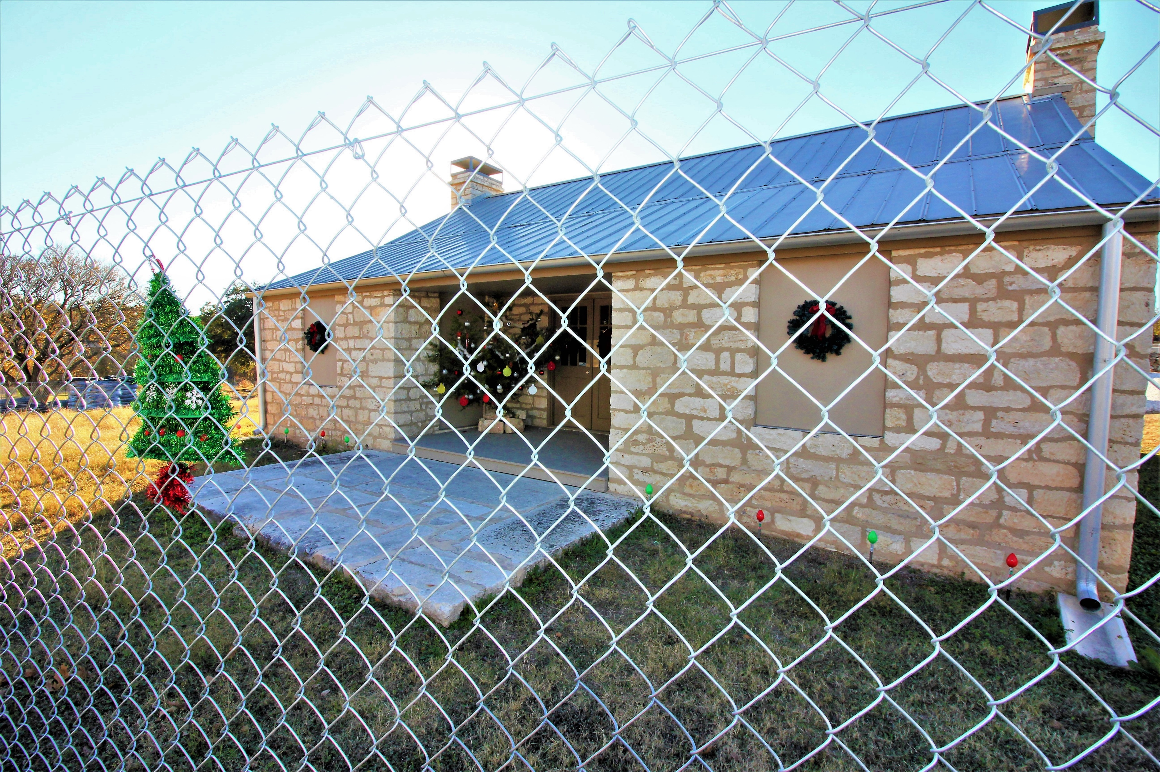
ACCOMPLISHMENTS (2022)
Project Fund Growth ($48,068 to $58,227 )
City Funds Historic Preservation Projects
- Annual: 3% HOT Funds
- One-time: $300,000 HOT Funds
Historic Preservation Month
Speaker - Art Displays – Artifact Display
Kenney Fort Visibility Project
(Kenney Fort Lunch & Learn)
Round Rock History Throw Project
Local Legend nominations
Anna Palm selected as Local Legend
J. W. Wilbarger nominated as Local Legend
RRP Newsletters (Dec, Jun, Sep, Dec)
Partnered in development of
Downtown Historic District Guide
Notes:
RRP uses donations to fund projects AND uses members dues for operations.
Last year, RRP grew donations for projects by $4K.
Each year, membership funds over $2k are transferred to the project fund account.
In this year’s budget, the City allocated annual funding for HP Projects & SCI Restoration Funding.
Those city funds are from Hotel Occupancy Taxes & do not add tax costs to residents.

Slide 10
ACCOMPLISHMENTS (2022)
Submitted two Local Legend Nominations
White Lime Company & William Walsh Family
James Wesley Wilbarger
Published RRP Newsletters
Mailed Holiday Greeting Cards
Partnered in History Lunch & Learn Program
Notes:
In 2021, RRP submitted two Local Legend Nominations.
Our Local Legend Nomination submitted by Elroy Haverlah on Anna Palm was selected as LL of the Year.
Our JW Wilbarger nomination was not selected; however, the Wilbarger nomination will be carried forward for re-consideration this year.

Slide 11
OUTREACH (2022)
Used Social Media (4 Facebook Pages)
(Advocated for relocation of endangered properties)
Meet with Palm House Association & Old Settlers Association to encourage Palm House Relocation
Partnered with Art & Culture Dept, Library, Baca Center, Historic Preservation (HP) Office, & Williamson County Museum during HP Month
Notes:
Outreach is key to keeping the community informed about RRP.
Our Round Rock Stagecoach Inn Facebook page has over 1,000 followers.
Our two other facebook pages are Round Rock Preservation and Explore Round Rock.
We frequently re-post RRP news to the “People of RR” Facebook Page that has 33.8K followers.

Slide 12
OUTREACH (2022)
RRP Directors serve on:
County HP Commission – Sylvia Forbes
Friends of the RR Library – Tina Steiner, Sylvia Forbes
County Volunteer Cemetery Group – Frank Darr
RR Slave Cemetery Committee – Tina Steiner
Black History Group – Tina Steiner
Coordinate with City on Stagecoach Inn Restoration
Conducted History Lunch & Learn Programs
Provided RR History and HP Education
Notes:
RRP board members serve on several organizations in the city & county.
RRP continued to meet with city leaders to discuss status of the RR Stagecoach Inn Project.
RRP continued our lunch and learn program and HP Month events.

Slide 13
Frank Darr – Vice President
Notes:
Our bylaws allow RRP to grow over time by expanding our board to 15 members.
Two of our 9 board members have expiring terms and have asked to be re-elected.
We previously e-mailed ballots to our members so they could cast their votes prior to this meeting.

Slide 14
RE-ELECTION
Frank Darr
Judy Anderson
Phebe Davol
Shirley Marquardt Blythe Plunkett
Frank Darr, Board of Directors
Notes:
Two board members have terms that are expiring.
Both directors want to serve another term from 2022 through 2024.

Slide 15
OTHER CANDIDATES
for
RRP Board of Directors
(2023-2024)
Frank Darr – Board of Directors
Notes:
No members outside the current board have told us they want to serve on the RRP Board of Directors during the 2022-2024 term.
If you are a member in good standing & want to be considered for a Board of Directors position, enter your name in the chat button now.
I will count the completed ballots and will announce the election results later in the meeting.

Slide 16
Judy Anderson – Membership Chair
Notes:
Next our membership Chair, Judy Anderson.
Judy contatnly works to maintain and grow the RRP Membership Program.

Slide 17
CURRENT MEMBERS
Dues Paid & in Good Standing
32
Cecelia Adair Tom & Susan Hutchison Shirley & David Tynan
Judy & Jim Anderson Dorothy & Randy Ingram Dave & Suzanne Waeltermann
Pamela & Scott Anderson Dave & Becky Laich Sandra L. Waeltz
Yolando Ara Laura Anne LeBlanc Scot & Carol Wilkinson
Dr. John Bartow Shirley Marie Marquardt
Floyd & Ann Butler Ellinor McElroy
Blane & Wendy Conklin Frank & Renee Petsche
Lisa Crawford Blythe Plunkett
Frank & Ann Darr Jennifer H. Prader
Phebe Davol Betty Richardson/James Bryant
Sylvia Forbes Ellen R. Skoviera
Kerstin Harding & Steve Sweat Tina Steiner
John & Kathleen Harris Steve Stephens
Sandra Homan Rae Lynn Tipping
Judy Anderson – Membership Chair
Notes:
RRP currently has 29 members and we have listed their names here.
RRP invite every business and individual to show support of preservation within the City of Round Rock through a RRP membership.

Slide 18
Kerstin Harding - Treasurer
Notes:
Kerstin Harding assumed the role of Treasurer after David Tynan, our Charter Treasurer, moved to Colorado.
RRP has already submitted required 2021 tax forms to the IRS.
Plus the annual audit for 2021 is currently under review.
The 2021 Audit Committee consists of members - Judy Anderson and Frank Darr.

Slide 19
Financial report
Summary: | Jan 1, 2022 | Dec 31, 2022 | Difference
Checking | $1,311.49 | $1,409.70 | $98.21
Savings | $48,067.69 | $58,227.08 | $10,159.39
Total | $49,379.18 | $59,636.78 | $10,257.60
2022 Income |  | 2022 Expenses
Member Dues ( ) | $ | Admin (PO box) | $ | Website $
Donations/grants | $ | Throws | $ | Domain $ Holiday Cards $
Donation matches (Dell) | $ | Book | $
Donations for goods | $ | Adv. Kit | $
Interest | $ | Postage | $
Total | $ | Total | $ | Difference | $
Notes:
The End of Year Financial Report is shown hee.

Slide 20
MINOR PROPOSED CHANGES
Notes:
Phebe Davol reviewed the RRP BYLAWS a couple of months ago.
Phebe, who served on the Board of Directors, will present those proposed changes.

Slide 21
Heritage Trail West
Notes:
The Heritage Trail West Project began on October 1, 2020, and was projected to take 18 months to complete.
The project was in full swing in 2021 until mid-summer.
At that time the contractor filed for bankruptcy and the project stopped.
The project has stopped until the legal processes are complete.

Slide 22
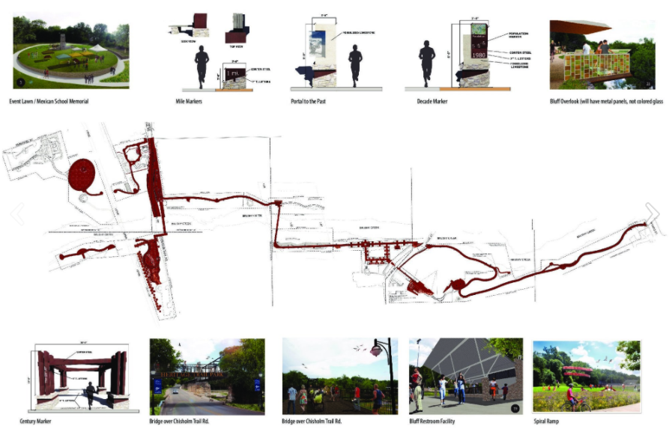
HERITAGE TRAIL WEST
(1 Mile Trail - Chisholm Trail Road to Mays Street – 10’ Wide)
Notes:
The Heritage Trail West will travel 1 mile east from Chisholm Trail Road to Mays Street.
The project includes the Bathing Beach Park, landscaping around the Stagecoach Inn, & the installation of the RRP Engraved Bricks.

Slide 23
RESTORATION
OLD STAGECOACH INN
Notes:
This year, the City of Round Rock budgeted funding on an annual basis using 3% of Hotel Occupancy Funds for HP Projects.
The City also approved a one-time allocation for the restoration of the RR Stagecoach Inn in the amount of $300K using HOT funds.
The City has started talks to develop am Architectural Design Project for an interior design of the Stagecoach Inn. That process will take 6-8 months to complete.

Slide 24
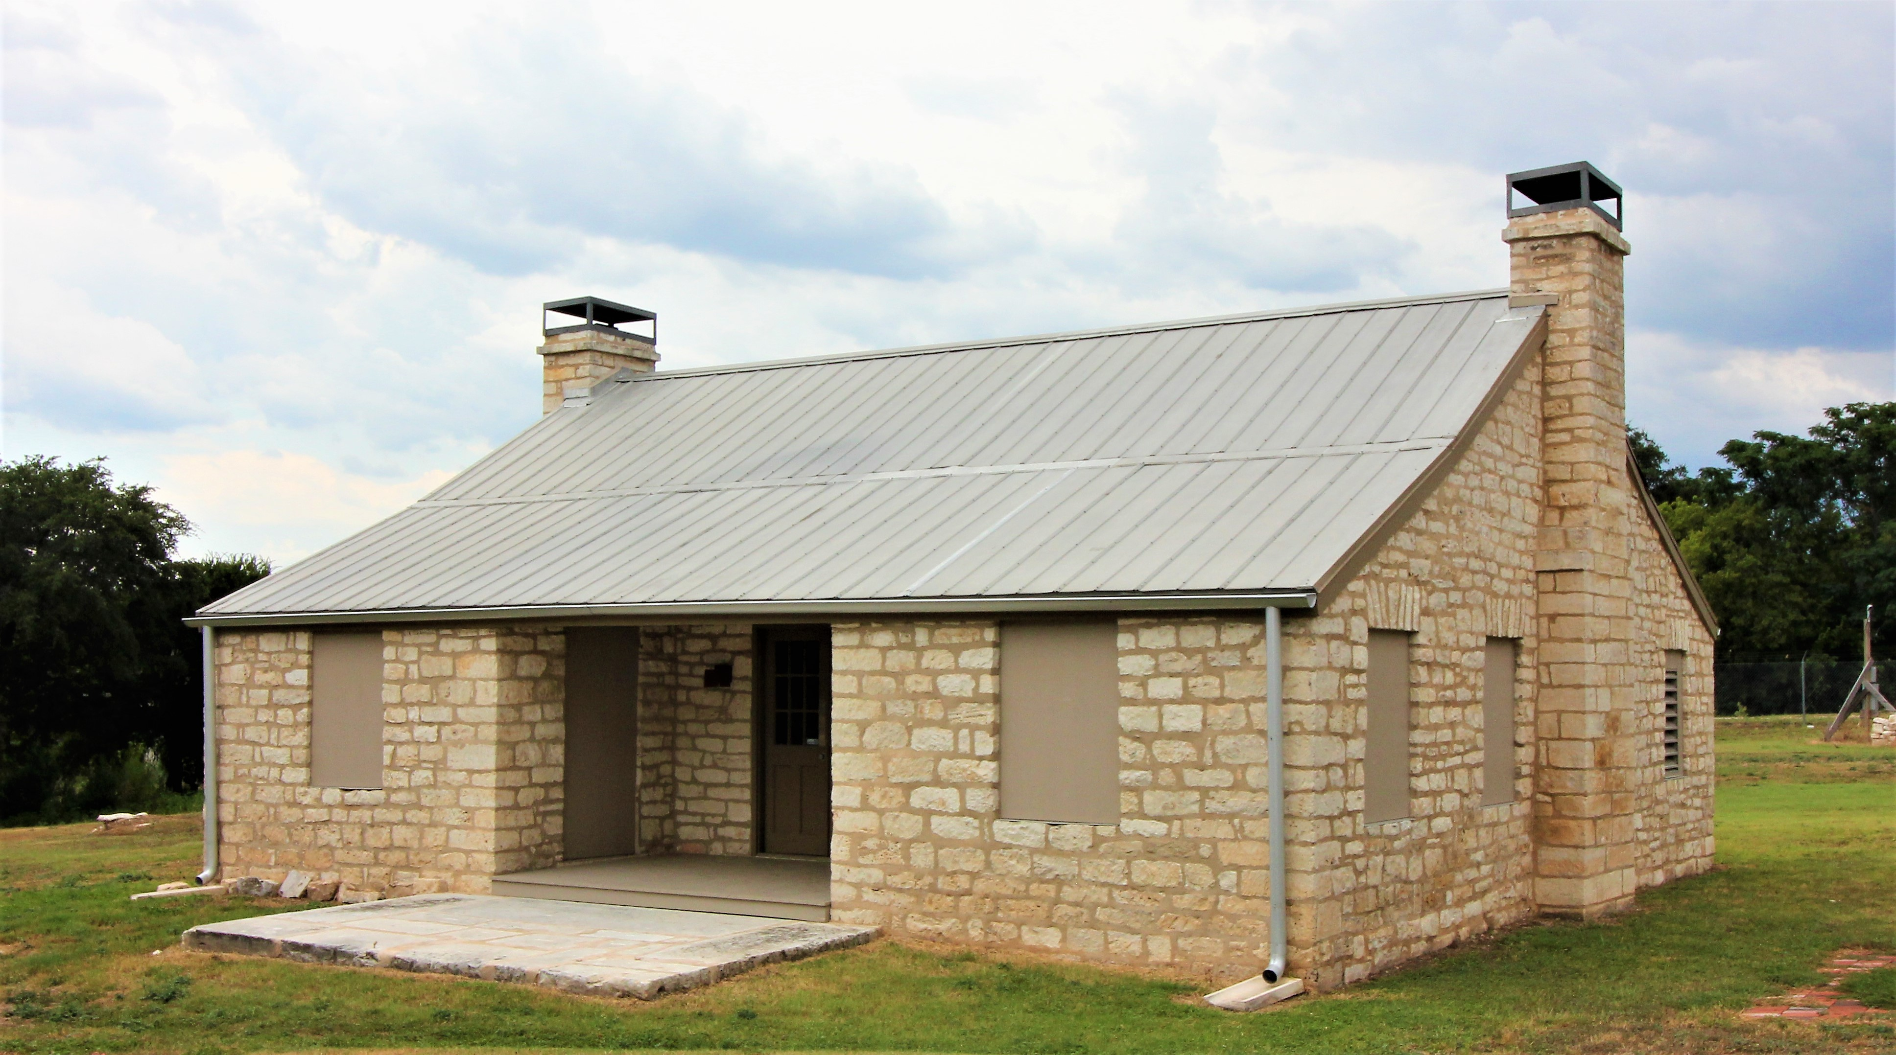
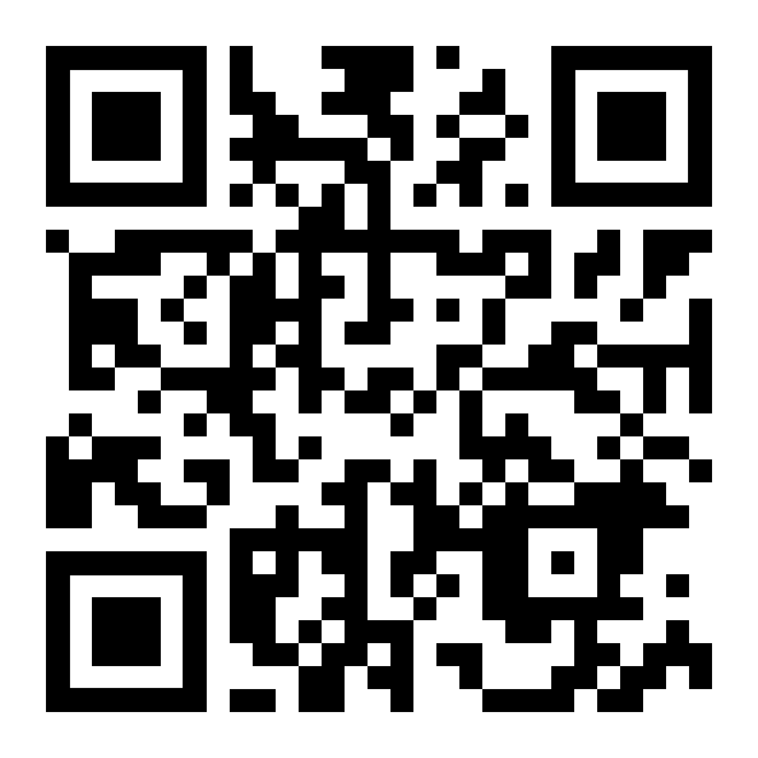
HOLIDAY GREETINGS FROM
OLD STAGECOACH INN (1848)
www.rrpreservation.org
Notes:
RRP wasn’t able to decorate the inn during 2021 because of contractor fencing around the Inn;
However, RRP obtained this sign during the holiday, which was posted outside the fence in front of the SCI.

Slide 25
KENNEY FORT
VISIBILITY
Frank Darr - Board of Directors
Notes:
Frank Darr has the lead on the Kenney Fort Visibility Project.

Slide 26
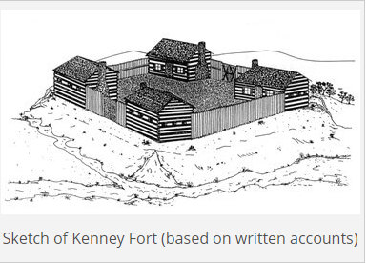
Notes:
This is a sketch of Kenney Fort.
Four Log Cabins were located at the corner of each site with gate openings at each end.

Slide 27
Built 1838
First Settlement in Williamson County
Associated with Early History of Texas
Santa Fe Expedition - 1841
Archives War - 1842
KENNEY FORT
Frank Darr, Board of Directors
Notes:
Kenney Fort is an important site for Round Rock History.
The fort, built in 1838, was the first settlement in Williamson County (prior to founding of the City of Round Rock.
While only being used for a few years, the site is associated with two very important Texas history events—the Santa Fe Expedition and the Archives War.

Slide 28
Why is project needed?
What are the plans?
What resources are needed.
KENNEY FORT
VISIBILITY PROJECT
Frank Darr, Board of Directors

Slide 29
CITY OF ROUND ROCK PRESERVATION PROGRAM UPDATE
Kerstin Harding, City of Round Rock

Slide 30
City Preservation Program Context:
Planning and Development Services Dept.
Part of long-range planning function
3 staff working on preservation (part-time)
Core functions are administrative:
Historic Preservation Commission (HPC)
Certificates of Appropriateness
Tax exemptions
Certified Local Government – completed 4-year review in 2021
Beyond core preservation functions:
Education and Awareness Plan (2009)
Creation of long-range planning group (2016)
Notes:
Notes:
Historic preservation functions are within the PDS dept., properties are designated with zoning
Of the planning staff there are 3 that spend part of their time on preservation
Core function is to administer the preservation ordinance, and for many years that was the extent of the preservation program:
Staff support for HPC, appointed by Council;
CofAs – certifies that an owner’s proposed alterations won’t compromise historic integrity
Tax exemption program incentive for timely maintenance so historic properties aren’t lost
CLG – best practice standards that our local program has to meet to remain eligible for grants
The other, cultural stuff we do – preservation month, compiling background info on properties, walking tour brochure etc – only been able to take on in the last 10 years or so.

Slide 31
City Preservation Program:
Noted at last year’s presentation
Most of focus on architectural review and tax exemptions
17 Certificates of Appropriateness
50 tax exemption applications and inspections
Hiring long-range planner – hired Feb 2021
Revised preservation portion of PDS website
Complete local landmark installation project; relocation markers
Telephone exchange relocation marker
15 marker installs (total 37 of 48)
National Preservation Month (May) social media prep
8 social media posts about history/preservation
Local Legends 2021 – awarded Nov. 2021
Annual updates to Council for Round Rock 2030
Notes:
Update on activities noted in last year’s update:
Most of our activity has been in administering architectural review (CofAs) and tax exemptions
17 CofAs (3 reviewed by HPC, 14 by staff)
Long-range planner
Website updated
Relocation marker researched/installed for telephone exchange building
15 more markers installed; total 37 of 48
3 either have given permission but not installed yet or want to wait until they finish painting first
2 want marker on pole instead of wall
1 does not want a marker at all
5 still have not responded (2 are new owners, 3 didn’t respond a couple years ago)
Preservation month activities: mostly partnering with RRP
Annual update to CC – made about 2 months ago? – will discuss in a minute

Slide 32
City Preservation Program:
Other notable items:
Texas Historical Commission’s 4-year CLG review (maintains CLG status)
Created walking tour brochure (with RRP/HPC)
Combining 1992 and 2010 historic resource survey data to prepare for update
Notes:
Other things did in 2021 that weren’t on the list:
4-year review of our preservation program for consistency with CLG standards
Nicole created a walking tour brochure with help from Shirley and Pamela Anderson (a commissioner)
Currently combining the historic resource survey data from the 1992 and 2010 historic resources surveys to check on changes to properties over time.
Historic Resources survey is one way to identify potential historic landmarks
listing of all properties at least 50 years old to identify properties that have historic significance and/or architectural integrity.
It’s a formalized process so that surveys can be compared between different areas and different times; needs to be revisited periodically
1992 survey was only looking for pre-1945 structures and within the city limits (with a few exceptions). Identified high-medium-low priorities.
Almost all the high-priority properties identified received historic zoning, but few of the medium or low.
2010 survey was recent but limited to the downtown area
See what’s still here and what may have aged into consideration

Slide 33
Notes:
The first year update on the comprehensive plan was delivered to Council last November

Slide 34
About Round Rock 2030
10-year plan adopted in June 2020; web version at roundrock2030.com
A comprehensive plan that guides implementation impacting land use
Includes a vision for Round Rock in 2030
Includes 12 policies with associated implementation strategies, including one on historic preservation
Includes the 10-year Historic Preservation Plan
Annual Report 2020-2021 is an update on implementation progress
New data
Implementation highlights by policy
Tie-ins with City Council Adopted Strategic Plan where appropriate
Overall summary at end of the report
Notes:
Round Rock 2030 is a 10-year comprehensive plan adopted in 2020.
Mostly a land use plan for long-range planning pruposes.
One overall vision statement
Stated 12 policies with lists of implementation strategies
One of the 12 policies relates to historic preservation
Recently delivered the 2020-2021 annual report to Council with progress on those implementation strategies

Slide 35
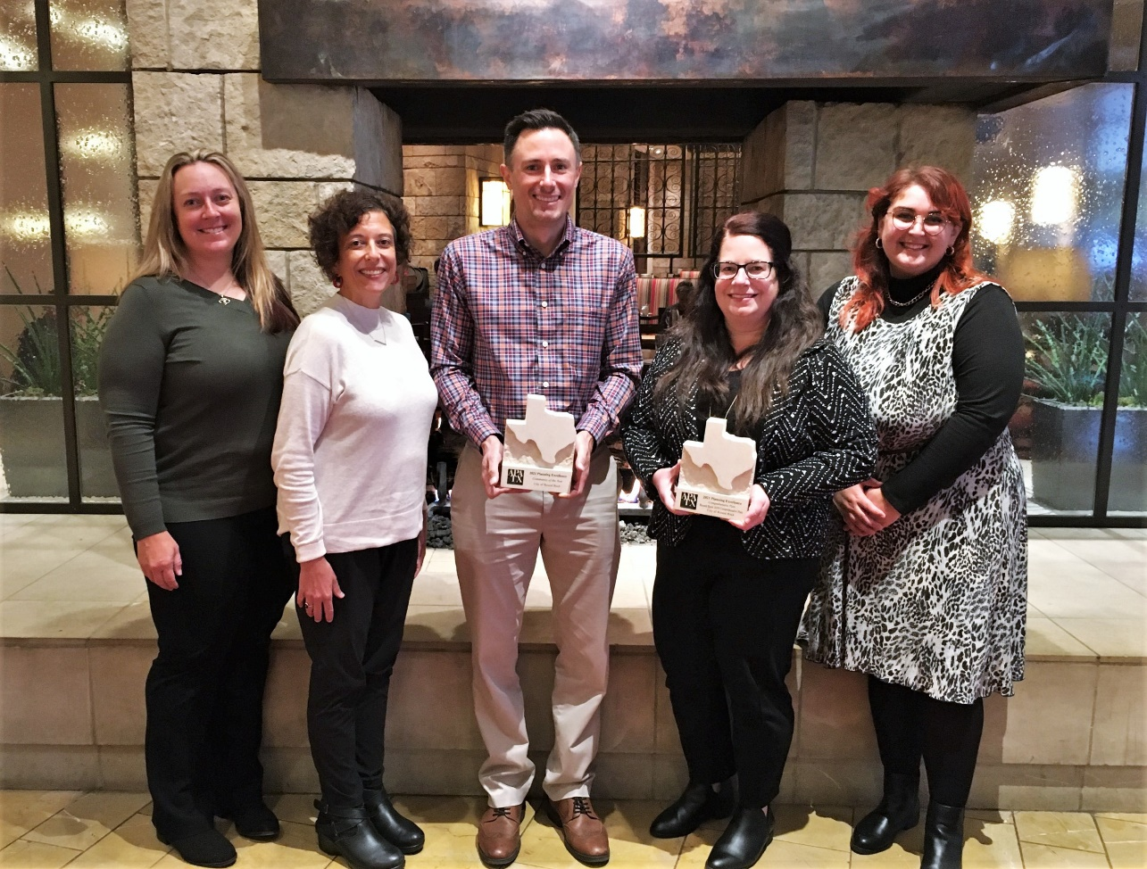
Plan Awards
The American Planning Association (APA) Texas Chapter selected Round Rock 2030 for the state Comprehensive Planning Award.
The awards jury was extremely impressed with Round Rock 2030 and felt that effort should be further rewarded by selecting Round Rock as Community of the Year.
Notes:
Also learned that the Texas chapter of the APA selected Round Rock 2030 fir the state comprehensive planning award.
Award committee impressed enough to also name Round Rock as Community of the year for its planning work.

Slide 36
Round Rock 2030 Vision
Round Rock is a safe, desirable, family-oriented community that balances progress and prosperity with its history, by prioritizing quality of life, mobility, economic development and thoughtful land use planning.
Notes:
Vision statement: what RR wants to become over the next 10 eyars

Slide 37
Round Rock 2030 - Implementation Historic Preservation
Historic Preservation Policy Statement:
Preserve buildings and sites that contribute to Round Rock’s history.
New Historic Downtown Round Rock, Texas walking guide created by Round Rock Preservation and PDS staff.
Several exhibits during Historic Preservation Month in May including the Art of Round Rock Plein Air at City Hall, Round Rock History Through the Eyes of Women at Round Rock Public Library, and Center Art Club at the Baca Center.
New HOT funds allocation starting in FY2022.
Notes:
The policy statement for Historic Preservation: Preserve buildings and sites that contribute to Round Rock’s history.
Updates on what was done to further the implementation strategies:
Walking guide as education and outreach info that is also useful to our Convention & Visitors’ bureau
Partnerships with other organization – in this case listing the preservation month activities done with Round Rock Preservation
and one of the implementation strategies was to identify new funding sources for the preservation program, and the Council announced that it would allocate part of its hotel occupancy taxes each year to preservation programs, with a one-year $300k allocation

Slide 38
Full report available at
ROUNDROCK2030.COM
Notes:
Round Rock 2030 has its own website where you can read updates on the other policies and implementation strategies.

Slide 39
Upcoming City Preservation Program Projects:
Update historic resources survey
Reconcile the 1992 and 2010 surveys (different geographies)
Check WCAD records by structure age for potential landmarks in annexed areas or that have aged into eligibility
On-site check of current state of historically significant properties from previous surveys and possible new significant properties
Tax exemptions (February – July)
Complete marker installations
Preservation month social media posts
Notes:
So – city preservation program projects coming up:
As mentioned, we’re reconciling the different historic resource surveys – different geographies, addresses have changed on some properties, some have been demolished
Also got WCAD to list structures by age as a first step in identifying properties that have aged into consideration….
… but ultimately there will be footwork to do – visit sites in person, and not sure yet how big that list is going to be and if we’ll need help
Tax exemptions - which as usual happen at about the same time as preservation month.
Complete the marker installations… for those that finish their painting projects and to adapt for pole mounting, and then try to contact the last 5 again.

Slide 40
Scheduled Partnering with RRP:
Current partnering opportunities should focus on the education/celebration piece + advocacy.
Preservation Month 2022 (May)
Publicity
Proclamation (April 28 City Council meeting)
Historic property profiles for social media
Music on Main (probably)
Distribute downtown walking tour/ kid activity book
Local History Presentation (RRP)
Lunch & Learns by staff
September 13: Old Town
November 8: New Town
Notes:
As noted, because tax exemptions some due during preservation month we really appreciate all that Round Rock Preservation does for it and we want to support it.
Use the city’s publicity channels
Identified a date to proclaim Preservation month,
Writing historic property info to share on social media – social media folks like them because they get more interation
Not certain MoM will happen, but decide what we want to do there
Shirley is working on exhibits at Baca and the Library and a Local History speaker
Staff will be speaking for two of the Lunch and Learns in September and November

Slide 41
MOVING FORWARD - HONORING THE PAST
PATH FOR 2022
Shirley Marquardt, RRP President
Notes:
What are RRP Plans for 2022.

Slide 42
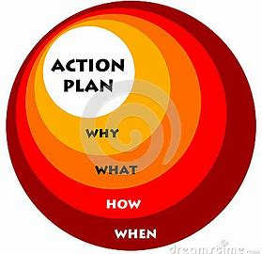
Educate – Inspire - Preserve
Grow Partnerships & Memberships
Continue Current Projects
- Restore Stagecoach Inn
- Kenney’s Fort Awareness
- History Throw Promotion
Preservation Month Event
Lunch & Learn Program
2022
Shirley Marquardt, RRP President
Notes:
RRP plans to grow our capabilities and accomplishments.

Slide 43
RRP BUCKET LIST
COMPLETE RR STAGECOACH INN
INSTALL KENNEY FORT SIGN
COLLECT HISTORIC PHOTOS
CREATE TOURS USING DOCENTS
GROW PARTNERSHIPS
Shirley Marquardt, RRP President
Notes:
This is the bucket list for RRP.
RRP aspires to accomplish a couple of new projects during 2022.

Slide 44
Judy Anderson – Board of Directors
Notes:
Sylvia Forbes, the 2022 RRP Awards Chair, is developing guidelines for next year’s awards.
RRP will then seek input from the public and the City during that process.
This year, RRP recognizes AWARDEES, who RRP believes helped move the RR HP Program forward for the community of Round Rock.

Slide 45
2021
ANNUAL RRP AWARDS
PARTNER OF YEAR
SUPPORTERS
BUSINESS – NONPROFIT - INDIVIDUAL
YOUTH
MEDIA
EDUCATION
RESTORATION
APPRECIATION-PUBLIC SERVICE
SPECIAL RECOGNITION
Judy Anderson – Board of Directors
Notes:
This charts list categories for this year’s RRP Awards.
RRP Awards recognize individuals and organizations, who have made significant contributions toward preservation goals and mission.

Slide 46
ROUND ROCK PRESERVATION
RECOGNIZES
CITY OF ROUND ROCK
AS
RRP PARTNER OF THE YEAR
2022
PARTNER
OF YEAR
AWARD
Notes:
The CORR is recognized for being a strong Partner since 2013, when RRP began efforts to save the RR SCI from demolition.
The City already had a HP Program.
In 2018, the city provided approximately $1M in Hotel Occupancy Taxes to relocate the RR Stagecoach Inn to 750 Chisholm Trail Rd.
The City also allocated $300K in HOT Funds in this year’s budget for the Restoration of the RR Stagecoach Inn.
The City’s commitment to preservation actions demonstrates the City of RR’s desire to preserve the heritage of RR for future generations.

Slide 47
ROUND ROCK PRESERVATION
RECOGNIZES
DELL TECHNOLOGIES
as
RRP BUSINESS SUPPORTER OF YEAR
through
“DELL YOUR CAUSE” PROGRAM
2016 – 2022
2022
BUSINESS SUPPORTER
OF YEAR
AWARD
Notes:
“Dell Technologies is recognized for their support of RRP since 2016 with Dell “Your Cause Funds.”
This support has been directed toward the restoration of the RR Stagecoach Inn.

Slide 48
ROUND ROCK PRESERVATION
RECOGNIZES
ROUND ROCK
WOMAN’S CLUB
as
NONPROFIT ORGANIZATION SUPPORTER OF YEAR
2019 – 2022
2022
NONPROFIT
ORGANIZATION
SUPPORTER
OF YEAR
AWARD
Notes:
The Round Rock Woman’s Club is recognized for their support of RRP Projects since 2019.
Their support has helped move preservation projects forward, which will enrich the lives of people in RR so they can enjoy RR Historic Assets into the future.

Slide 49
ROUND ROCK PRESERVATION
RECOGNIZES
as
INDIVIDUAL SUPPORTERS OF YEAR
FOR SUPPORTING
PRESERVATION PROJECTS
IN ROUND ROCK
2022
INDIVIDUAL SUPPORTERS
OF YEAR
AWARD
Notes:
Paul and Yael Goode are recognized as Individual Supporters of the Year.
Each year they have supported preservation efforts and projects in RR.

Slide 50
ROUND ROCK PRESERVATION
RECOGNIZES
2022
YOUTH AWARD
Notes:
Abby Robison is recognized a Youth Preservationist.
She has a true passion for history & RRP is honored by her gift to the community of “A Kid’s Guide to the History of Round Rock.”

Slide 51
ROUND ROCK PRESERVATION
RECOGNIZES
2022
YOUTH AWARD
Notes:
Christopher Chase is recognized as a Youth Preservationist.
Christopher loves history & partnered with RR Parks & Recr Div to design an Engraved Brick Display for the RR Stagecoach Inn within the Bathing Beach Park.
Christopher led fellow Boy Scouts in creating a prototype brick display to the north of the Inn.
Since that time Christopher has achieved Eagle Scout Status and will attend Texas A&M after he graduates from RR HS this year.

Slide 52
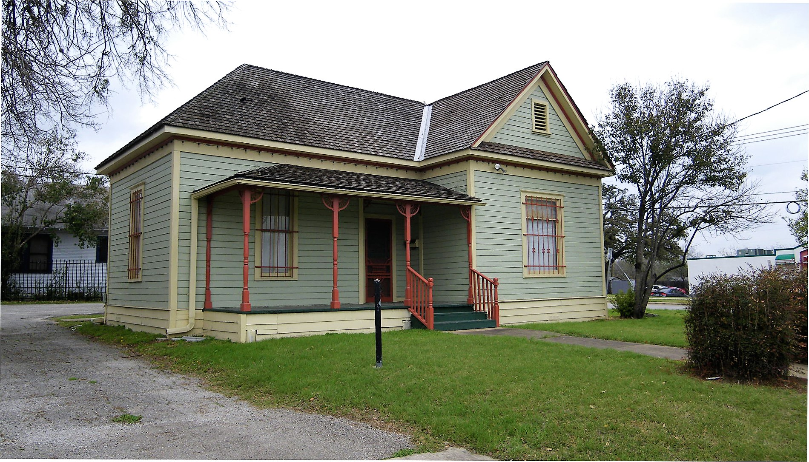
Round Rock Preservation
recognizes
SAM & BEVERLY BAKIR
HISTORIC PROPERTY OWNERS
ROUND ROCK
TELEPHONE EXCHANGE OFFICE
relocated from106 N Mays St to
803 E Liberty St (Suite 200)
AS
RESTORATION PROJECT OF YEAR
(Endangered Place)
2021
RESTORATION PROJECT OF YEAR
Notes:
Sam and Beverly Bakir are recognized for the RR restoration project of the year.
IN 2019, the historic RR Telephone Exchange house WAS threated with demolition and the Bakir family RELOCATED that building FROM 106 N. MAYS TO 803 E. LIBERTY TO PREVENT ITS DEMOLITION.
They relocated and restored the building and are now leasing the property to an attorney.

Slide 53
Round Rock Preservation
recognizes
FOR
MEDIA PRODUCTIONS
2022
MEDIA AWARD
Notes:
The City of Round Rock Library is recognized for producing 10 Texas Time Machine Productions during 2021.
These productions highlighted the rich history and heritage of the City of Round Rock.
Chris Sauder is commended for researching, developing and producing these media productions and making them available to the public.

Slide 54
TEXAS TIME MACHINE
2021-2022 MEDIA PRODUCTIONS
Immortal 10 Tio Dan Balderas & Puffy Tacos
Sam Bass Texas Chain Saw Massacre
Leanderthal Lady Veterans Park
Anna Palm & Palm Family Round Rock Leader
Dr. Black’s Murder Old Stagecoach Inn
Next Production (20Feb22) Hopewell Colored School
2021
MEDIA AWARD
Notes:
This chart lists the productions released during 2021.
The next production will be released on Feb 20, 2022, during Black History Month entitled “Hopewell Colored School.”

Slide 55
Round Rock Preservation
recognizes
FOR
PROVIDING EDUCATION
ABOUT
201
2022
EDUCATION
AWARD
Notes:
Elroy Haverlah is recognized for providing history education in Round Rock.
He authored several history books about Swedish Heritage in Texas and served as the guest speaker for our 2021 HP Month History Program.
Elroy also served as a speaker for a lunch and learn program about Kenney Fort.

Slide 56
ROUND ROCK PRESERVATION
recognizes
for
19 YEARS PUBLIC SERVICE
2022
PUBLIC SERVICE
APPRECIATION
AWARD
Notes:
Joelle Jordan is recognized for 19 years Public Service in the Planning & Dev Svc Div and serves as the City’s Principal Long-Range Planner.
Joelle holds the important position as the City of RR Historic Preservation Officer.
During her 19 years as a public servant, Joelle has strengthened and successful lead the City’s Historic Preservation Program.

Slide 57
ROUND ROCK PRESERVATION
recognizes
for
Round Rock
Preservation Achievements
2022
SPECIAL RECOGNITION
AWARD
Notes:
Shirley Marquardt-Tynan is recognized for being one of the Founding Organizers and Members of RRP.
Shirley originated the Idea to start a campaign to Save the RR Stagecoach Inn.
She serving on RRP Bd of Directors from 2016-2021 and filled the position of Charter Secy.
During 2021, she designed and created the RRP Library Display during HP Month.
Shirley has continued her RRP membership after her move to Colorado in 2021.

Slide 58
ROUND ROCK PRESERVATION
recognizes
for
Round Rock
Preservation Achievements
2022
SPECIAL RECOGNITION
AWARD
Notes:
David Tynan is recognized for being one of the Founding Organizers and Members of RRP.
David served as the RRP Treasurer from 2016-2021 while serving on the Board of Directors.
David has continued his RRP membership after his move to Colorado in 2021.

Slide 59
FRANK DARR

Slide 60
Congratulations
SHIRLEY MARQUARDT
BLYTHE PLUNKETT
FRANK DARR
Notes:
I congratulate Shirley and Blythe for being elected to serve another term of office on the RRP Board of Directors from 2022-2024.
They will continue as Directors of the RRP Board.
They will serve along with Judy Anderson, Frank Darr, Phebe Davol, Sylvia Forbes, Kerstin Harding, Richard Parson, and Tina Steiner.

Slide 61
ATTENDEE INPUT
Shirley Marquardt
Notes:
At this point, we will cover comments previously typed into the Chat Box. You may also enter other comments at this time.

Slide 62
e-mail: roundrockpreservation50@yahoo.com
Group Facebook Pages:
- Round Rock Preservation
- Round Rock Stagecoach Inn
- Explore Round Rock
Website: https://www.rrpreservation.org
Text: 512-568-5875
CONTACT US:
ROUND ROCK PRESERVATION
Notes:
Feel free to contact RRP at any time.
Our contact information is shown on this chart.

Slide 63
NEXT RRP BOARD MEETING
MARCH 8, 2022, 7 P.M., ZOOM
Notes:
Thank you for attending the 2021 RRP Annual Membership Meeting.
RRP requests your continued support of Preservation throughout 2022.
As President of RRP, I adjourn the Annual Membership Meeting of RRP.

